Slide 1
TU856-1 & TU858-1 Computer Architecture and Technology Module Code: CMPU 1006
Semester 1, Week 1
COMPUTER ARCHITECTURE AND TECHNOLOGY –
the Module Overview
Presenter: Dr Art Sloan

Slide 2
Presentation Outline
This presentation, a short one for the first part of this first week, introduces the module called ‘Computer Architecture and Technology’.
It will describe module content (which are the lecture notes), continuous assessment ideas and important dates.
There is a reading list which can be viewed as arbitrary.

Slide 3
Presentation Content
Lecturer and Website Details
Enrolling in Brightspace
Teaching Methods
Assessment Methods
Module Description and Aim
Syllabus
Lecture Headings
Computer Labs
A Reading List
Introduction Summary
Where to Next?

Slide 4
Lecturer and Website Details
Lecturer: Dr Art Sloan
Office location: CQ 214 Area 5
Phone No: 01 220 5638
E-Mail Art.Sloan@tudublin.ie
Web page: Brightspace
Computer Architecture and Techno CMPU1006
Notes and news will appear here, from week to week. (All lecture notes will be available, as ‘links’, by @ Week 13)

Slide 5
Enrolling in Brightspace
Log on to Brightspace
Use the ‘Discover’ feature to find the module
Search on ‘Computer Architecture and Techno CMPU1006’
- you will need to choose the one that mentions ONE of your courses’ Year; ‘TU856-1’

Slide 6
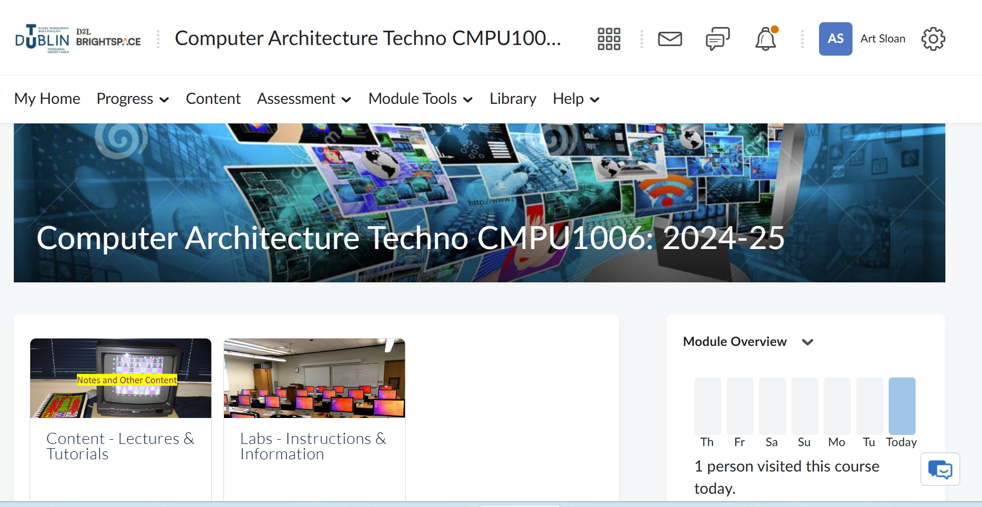

Slide 7
Teaching Methods
Lectures (Art Sloan) Labs Groups A – E Tutorials (Art Sloan)
The timetable may change but…
Labs: Mondays, 2.00 – 3.00pm:
Group A with me, Art, in lab CQ 237
Group B with Prasanjit Dey in lab CQ 236
Group C with Thomas Lee in lab CQ 240
Group D with Paul Bourke in lab CQ 233 and
Group E with Jelena Vasic in lab CQ 235
Lectures: Mondays, 3.00 – 4.00pm, in CQ LG 22 and
4.00 – 5.00pm, in CQ 006
Tutorial: Thursdays, 4.00 – 5.00pm in CQ LG 22.

Slide 8
Teaching Methods (2)
Each week the PowerPoint presentation file (.pptx) for lectures will be activated as a link on the Brightspace portal, in the Content area.
Lab instructions file, as a link, and the tutorial presentation file will also be in this area. Labs have their own page in Content.

Slide 9
Assessment Methods
Case study assignment in Semester 40%
(Two online quizzes, in lab time, during Week 6 and Week 11 (this may be subject to change))
Written examination 60%
Usually taken in May of the calendar year.

Slide 10
Module Description:
The module provides an overview of the discipline of Computer Architecture and describes how it relates to Computing Technologies.

Slide 11
Module Aims:
To provide the student with the theoretical foundations for other modules on the course.
To provide the student with the necessary background knowledge to understand and intuit what is reasonable to expect of modern computers and what is not.
To provide experience of the internals of typical modern computers and an overview of hardware and software, particularly the operating system.
To provide a grounding for programming, system deployment, configuration and troubleshooting.
To develop an appreciation and understanding of the architecture and operation of a small generic CPU.
To develop an appreciation and understanding of the architecture and operation of a typical computer system and its peripherals.
To instill an appreciation of the broader role of computers.

Slide 12
Module Objectives:
On completion of the course students will:
demonstrate a knowledge of number systems, Boolean algebra, sets, logic, relations and functions
identify and describe the major components of a typical general-purpose computer
describe the operation of an idealised generic computer
outline where a typical modern computer deviates from the idealised version
use the course topics to solve computing problems
use appropriate software and hardware to solve problems
identify, and differentiate between, different types of computer systems
identify, and describe the operation of, basic logic circuits
convert between, and perform elementary arithmetic and other operations in number systems including binary, octal, decimal, and hexadecimal

Slide 13
General Subject Matter:
Computer architecture and operation
Hardware and peripherals
Computer applications

Slide 14
Syllabus:
Digital aspects - Introduction and History: from valves to integrated circuits
Electrical aspects: Voltage, current, resistance, Ohm's law
Architectural aspects - Introduction and History: from Babbage to multi-core processors
Sequential logic: latches, flip-flops, shift-registers, and counters

Slide 15
Syllabus (2):
Binary, Octal, and Hexadecimal representations and buses
Logic gates: AND, NAND, OR, NOR, XOR, NOT
Von Neumann architecture and stored program computing: ALU, memory, program-counter (or instruction pointer), registers, instruction decoder, fetch-execute-store cycle, data and address buses

Slide 16
Syllabus (3):
Components: interfaces, hardware, and operation of: disk, memory, serial, parallel, graphics, audio and network subsystems
Contemporary and historical removable media (E.G. floppy disk, tape, CD, DVD, flash key)
Contemporary and historical external interfaces (E.G. PC parallel port, PC serial port, PS/2 ports, USB, IEEE-1394 "Firewire", SCSI, Ethernet)

Slide 17
Syllabus (4):
Contemporary and historical internal interfaces (E.G. AGP, SATA, PCIe, PATA, PCI, ISA, EISA, NuBus, MCA, AGP, VESA)
The list, as above, is of the basic features of the subject. Time permitting, we can look at case studies of networks and computer systems in organisations to give the subtopics some context.
These examples will be covered to complete the notes – just ahead of revision and analysis of past examination papers.

Slide 18
Proposed Lecture Headings (1 of 2)
Week 1: Module Introduction (Monday) and
Computers – an Historic Overview
Week 2: BANK HOLIDAY (3rd February, and
NO tutorial on Thursday 6th)
Week 3: Electricity to Electronics
Week 4: Number Bases
Week 5: Boolean Algebra and Logic Gates
Week 6: Sequential Logic
Week 7: von Neumann Architecture

Slide 19
Proposed Lecture Headings (2 of 2)
Week 8: BANK HOLIDAY (17th March, and
NO tutorial on Thursday 20th)
Week 9: Interface Types (Internal Hardware)
Week 10: Networking
Week 11: Software Types and Applications
Week 12: Revision (after Easter break)
Week 13: REVIEW WEEK – Self Study

Slide 20
Computer Labs
For labs in Weeks 1 – 11 I will place in the Brightspace ‘Lab Information’ page, content and links that relate to that week’s topic.
The lab folder for each week will have content, video clips and exercises. I will set up a one-hour session each week for this. (Labs on Mondays, 2.00pm apart from the Bank Holiday Mondays).
Using the Cisco NetAcad web portal with selected topics.

Slide 21
Revision
One or two sessions in lecture and tutorial time on a past exam paper and the main topics covered – expected to be in Week 12 - just in time for the ‘exam season’ and as an aid to exam preparation for this subject.
Included: description of the exam in terms of time allocated, number of questions and question options… tips on pacing answers to questions… what is expected of a scripted answer… questions from the group answered.

Slide 22
Semester Time Available
Weeks 1, 3, 4, 5, 6 and 7 have normal lectures. Week 3: a Bank Holiday on Monday 3rd February, so nothing extra on Thursday 6th.
Week 8 – Bank Holiday with no tutorial on Thursday 20th March.
There is a 2-week Easter break between Week 11 and Week 12.
Weeks 9 – 11, normal lectures. Revision in Week 12.
End of Semester 2: Friday 9th May 2025
Exam weeks (expected):
12th – 16th May (Week 14)
19th – 23rd May (Week 15)

Slide 23
Reading List
The ‘core texts’ are these books (from the course document):
Essential Computer Mathematics, Schaum’s Outline Series
Seymour Lipschutz, 1987, ISBN 0-07-0379990-4
Knowledge Management Case Book: Siemens Best Practice, 2nd ed.,
Tom Davenport, Gilbert J.B. Probst , 2002, Wiley
Essentials of Computer Architecture, 1st ed.,
Douglas E. Comer, 2005, Pearson Prentice Hall, ISBN 0-13-196426-7
(Purchase of books very much optional.)

Slide 24
Background Reading List
Supplemental Reading (from the course document):
Operating Systems, 4th ed..
William Stallings, 2001, Prentice Hall; ISBN 0-13-031999-6
Logic and Discrete Mathematics; A Computer Science Perspective
Winfred Karl Grassmann and Jean-Paul Tremblay, 1996, Prentice Hall, ISBN: 0-13-501206-6
Discrete Mathematics
Seymour Lipschutz and Marc Lars Lipson, 1997, Schaum’s Outline Series, ISBN 0-07-038045-7

Slide 25
A Good Book That I Have Looked At:
Introduction to Information Systems
James A. O’Brien
McGraw Hill
This is a good book that has a lot of technical detail.
Computer Science: An Overview – 12th Edition
J. Glenn Brookshear
Addison Wesley
Broad-based – a general view of Computing. Easy to read. This one is around €70 - €80!
Principles of Business Information Systems
Ralph Stair and George Reynolds
Course technology - Cengage
Another technical book.

Slide 26
Introductory Books:
(You may think these are a bit ‘low-level’…)
Computer Concepts
June Parsons and Dan Oja.
TP/Course Technologies (Thomson)
The 10th edition of this book is available in some bookshops and costs around €60.
Or
How Computers Work – 9th Edition
Ron White
Que
This is a great book insofar as it is clear, easy to read and has lots of pictorial examples. You may prefer this book to Computer Concepts. It costs around €35 online.

Slide 27
Older Introductory Books (but great in their time):
Computers! - 5th Edition,
Timothy Trainor and Diane Krasnewich.
McGraw Hill 1998.
Management Information Systems
Kenneth Laudon, Jane Laudon
Prentice Hall
These should be in the library – if you ever get to it this year! You can buy Management Information Systems if you like the look of it. Computers! is an older title and may not be available to buy new.

Slide 28
End of Introduction
That describes the module content and some of the features and events of Computer Architecture and Technology.
Are there…
ANY QUESTIONS?

Slide 29
Where to Next?
NEXT (next hour today):
The first of those content lectures:
“Computers – an Historic Overview”
How have computers evolved over 100 years? What is this architecture? How are they ‘systematic’? We can look at these things next.

